Slide 1

Automata and logic for regular functions
15/03/2022 / MB2.24 / Yang Tang ID:1899264

Slide 2
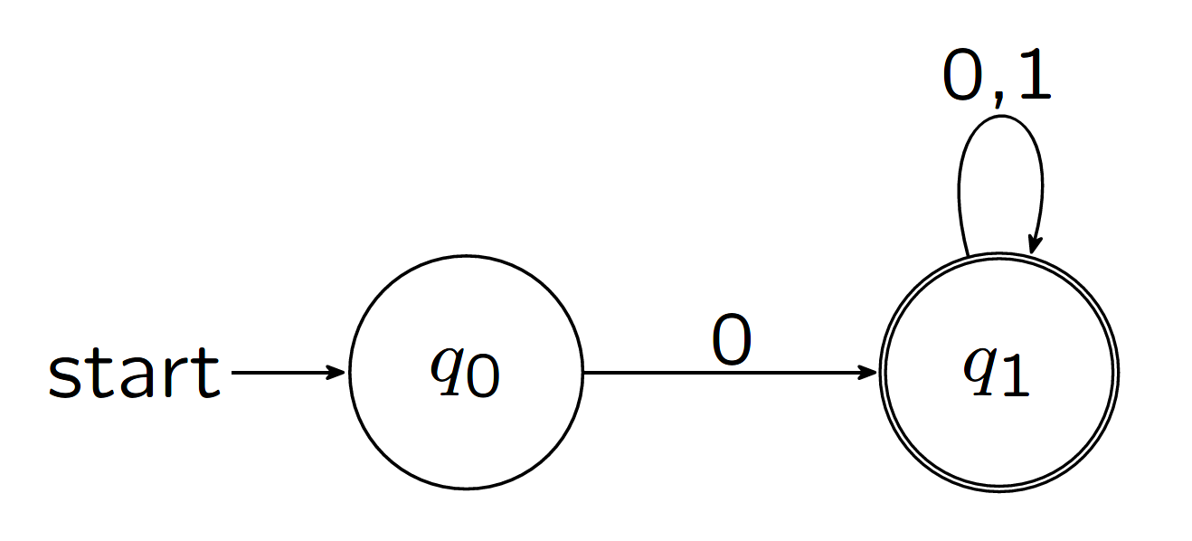
Regular Languages
Natural: Intuitive operational model of finite-state automata.
Robust: Alternative characterizations and closure properties.
Analyzable: Algorithms for emptiness, equivalence …
Applications: Algorithmic verification, text processing …
DFA example
Notes:
What is the analog of regularity for defining functions?
Do we really need such a concept ?

Slide 3
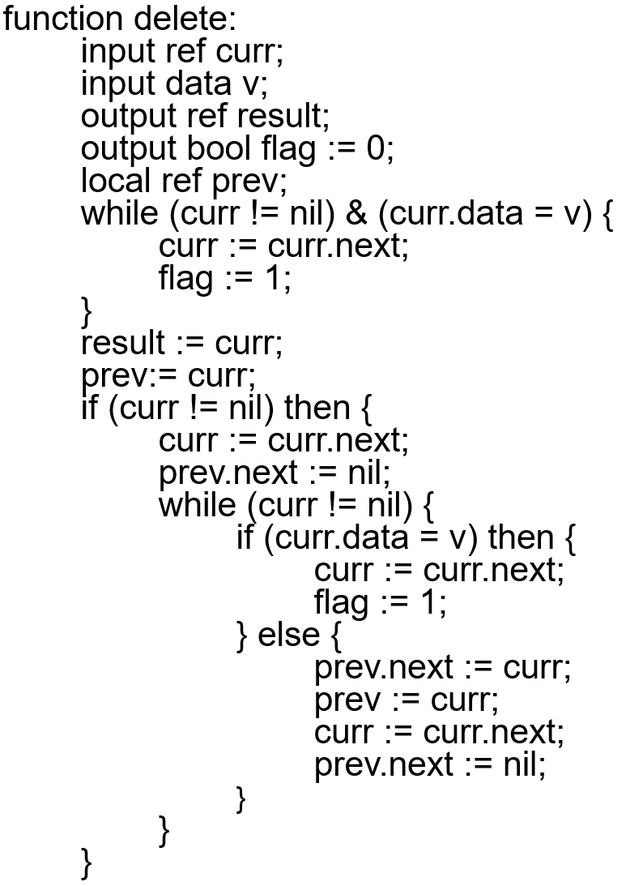
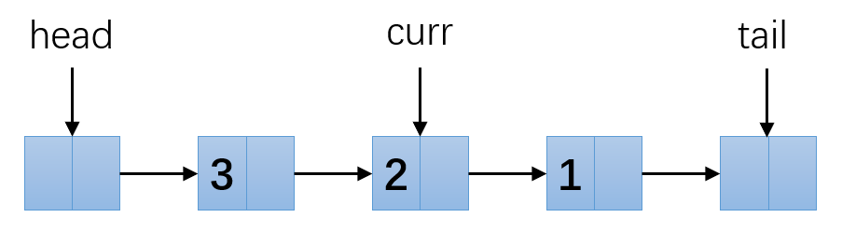
Verification of List-processing Programs
We can preform a simple function D* →D* using such as a program
Typically: Insert, Delete, Reverse …

Slide 4
Regular functions
Applications: list-processing programs verification, document transformation
Defined by variation of classical finite-state automata
Closed under sequential composition
Decidable to check equivalence
The ratio of the length of the output string to the length of the input string is bounded by O(n)

Slide 5
Project objectives
Simulate different transducer models that express regular functions
- Deterministic two-way finite state transducers (2DFT) [Gisburg and Rose, 1966]
- Deterministic streaming string transducers (SST) [Alur and Cerný, FSTTCS 2010]
- Deterministic MSO transducers (MSOT) [Engelfriet and Hoogeboom, ACM TOCL 2001]
Simulate translation algorithms between different models
- 2DFT ↔ SST [Dartois, Jecker and Reynier, DLT 2016]

Slide 6
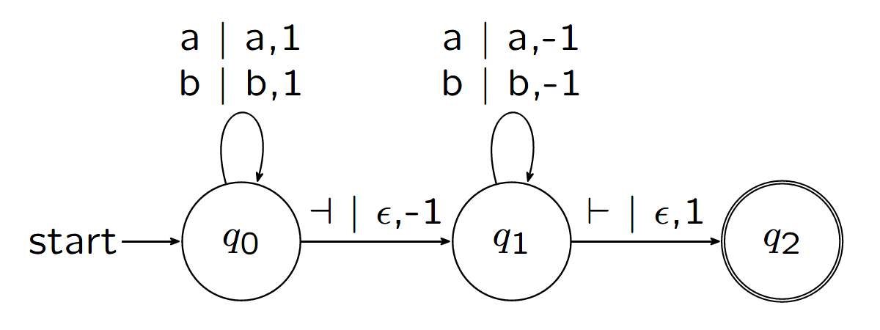
Deterministic two-way finite state transducers (2DFT)
Consist of finite sets of states, input and output alphabet, initial and final states and a transition function
Different transition function comparing to DFA (output symbol and moving direction)
Closure under sequential composition (Chytil and Jákl, ICALP 1977)
2DFT example
Reading head:
Input string:
⊢
a
b
b
⊣
a
b
a
b
Output string:
b
b

Slide 7
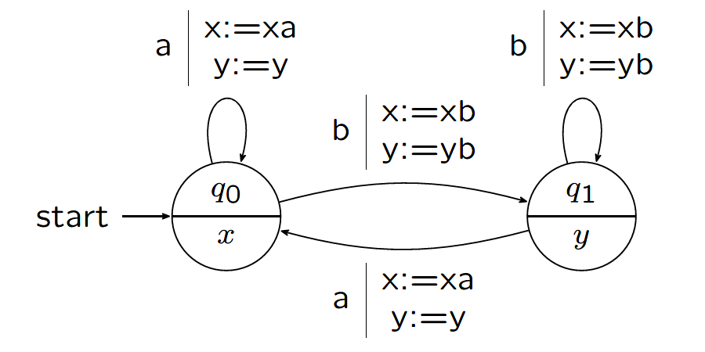
Deterministic streaming string transducers (SST)
One-way transducer with registers (variables)
Consist of finite sets of states, input and output alphabet, an initial state and three functions: partial output function, state transition function, variable update function
Copyless: each variable x can be used at most once in the output function and variable update function
SSTs have advantages in type checking and equivalence checking problems (Alur and Cerný, POPL 2011)
SST example
Reading head:
Input string:
a
b
b
a
b
x:
b
Variables:
y:
b
b

Slide 8
Tools chosen for implementation
Java – object-oriented programming language
Git – version control tool
GitHub – Cloud storage and version control
LaTex and TikZ library – graphical output

Slide 9
Project management and challenges
Plan-based Methodology
Early start time
Greatest challenge: Redo translation algorithm from 2DFT to SST
- Technical difficulties
- Time consuming
- Reflection helps the remaining project

Slide 10
Testing
White-box testing – all branches tested using 6 different transduction functions
Conclusion and Evaluation
All test passed - The system created achieves most of the goals set upon initialising the project
A number of new concepts and algorithms were learned and put into practice.
One algorithm was abandoned and replaced (no comparison made).

Slide 11
Future work
More transducer models
More translation algorithms
I/O - A graphical user interface (GUI) could be more efficient and intuitive when interacting with users.

Slide 12
Programme Demo

Slide 13
Summary
Regular Languages
Regular functions
Project objectives: Implement chosen models and translation algorithms
Two models: 2DFT and SST
Tools chosen for implementation: Java, Git, GitHub, LaTex, TikZ
Plan-base project management
Challenge: Redo translation algorithm
White-box testing
Conclusion and Evaluation: success but still improvable
Future work: more models and translation algorithms, GUI
Thank you!

Slide 14
Q & A

